Slide 1
Robot Assignment 2
Group:
Tran Vu Duc
Dao Tuan Anh
Dong Viet Hoang

Slide 2
Achivement
Challenge 01: Object detection and Classification on First View Cameras
Challenge 02: Drawing Trajectories on Top-View Map of the room

Slide 3
Table of contents
1. Ideal
2. How to do?
3. Demo
4. Discussion

Slide 4
Challenge 01
Object detection is a common problem when it comes to computer vision. Knowledge and understanding in this area, however, is maturing rapidly, mainly because of advances in deep-learning models. The goal of object detection is to pinpoint and classify objects of interest appearing in an image.
In this Challenge, We choose You Only Look One (YOLO) model directly predict bounding boxes and class probabilities
The simplicity of the YOLO model allows real-time predictions that very necessary for computer vision

Slide 5
What is YOLO?
Initially, the model takes an image as input. Its divides it into an SxS grid. Each cell of this grid predicts B bounding boxes with a confidence score. This confidence is simply the probability to detect the object multiply by the IoU between the predicted and ground truth boxes.

Slide 6
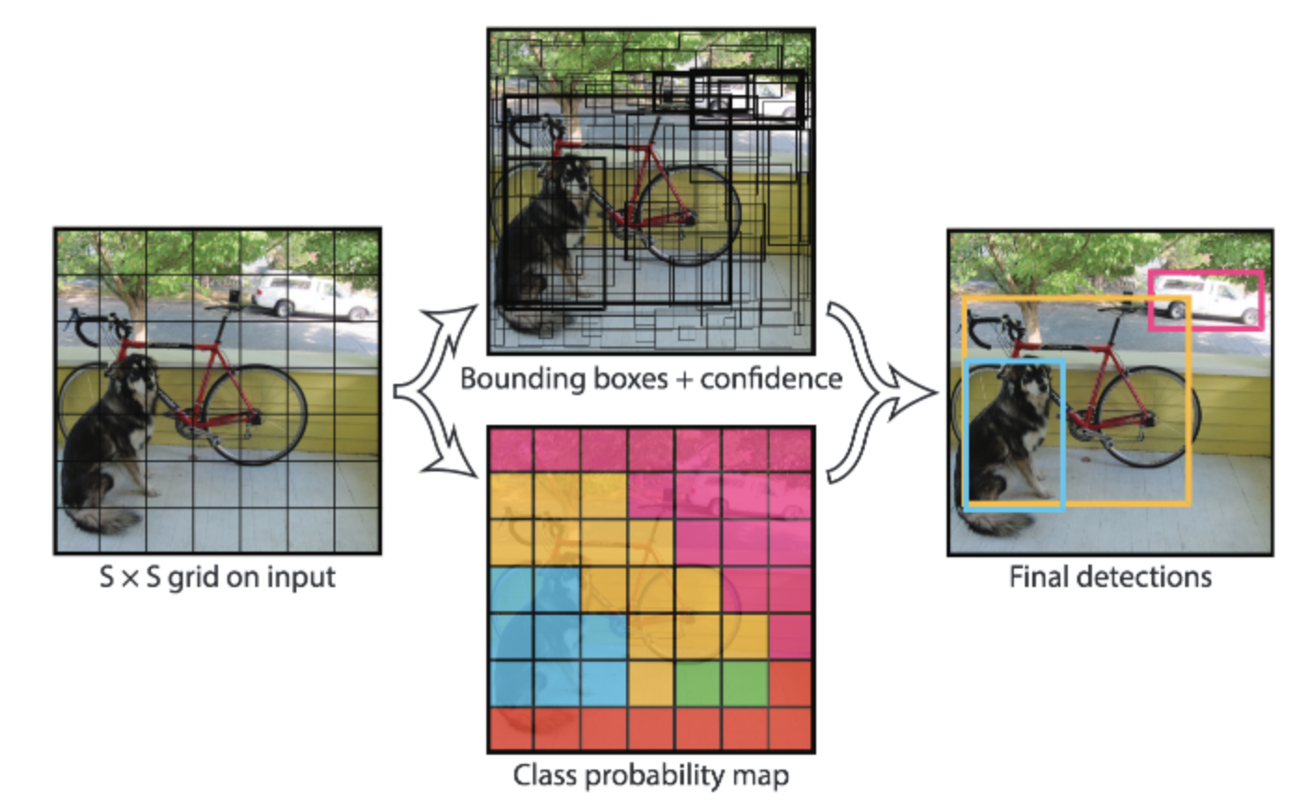
Example of application. The input is divided into an SxS grid, B bounding boxes are predicted(regression) and a class is predicted among C classes (classification) over the most confident ones. Source: J.Redmon and al.(2016)

Slide 7
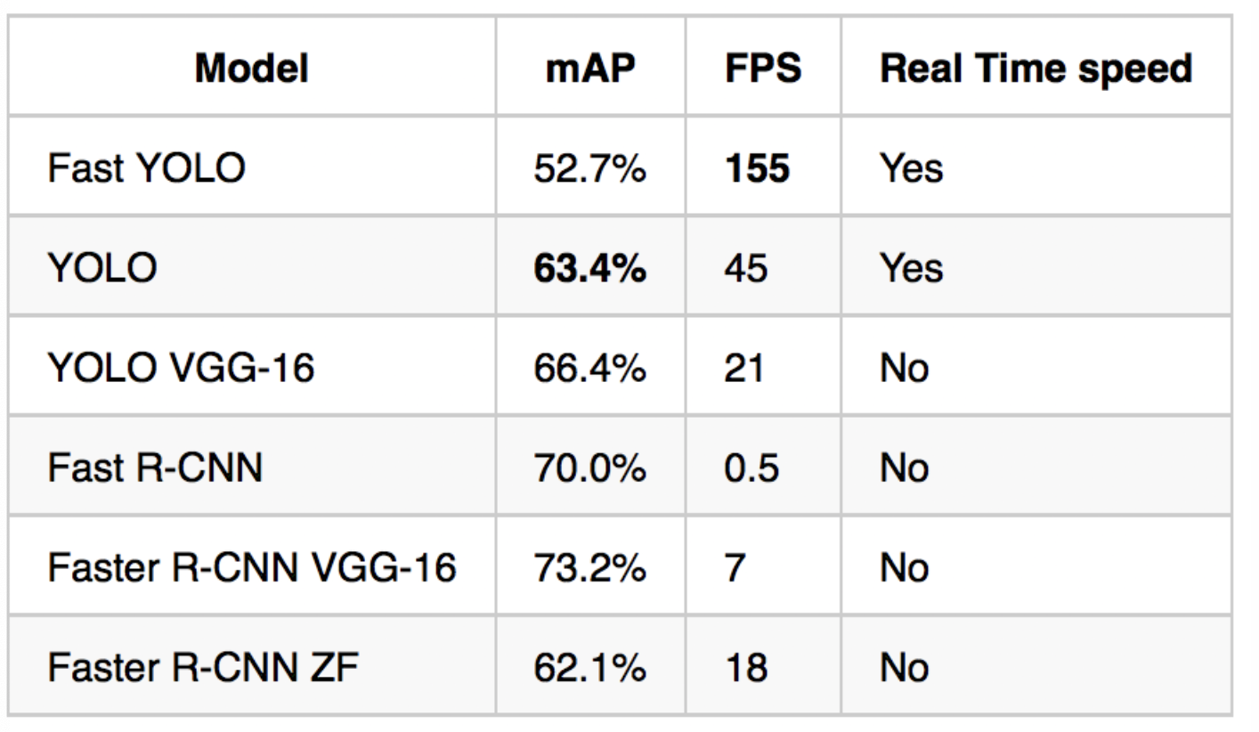
The YOLO model has a 63,7% mAP score over the 2007 PASCAL VOC dataset and a 57,9% mAP score over the 2012 PASCAL VOC dataset. The Fast YOLO model has lower score but they both real time performances. The published results correspond to the implementation of J.Redmon and al(2016)

Slide 8
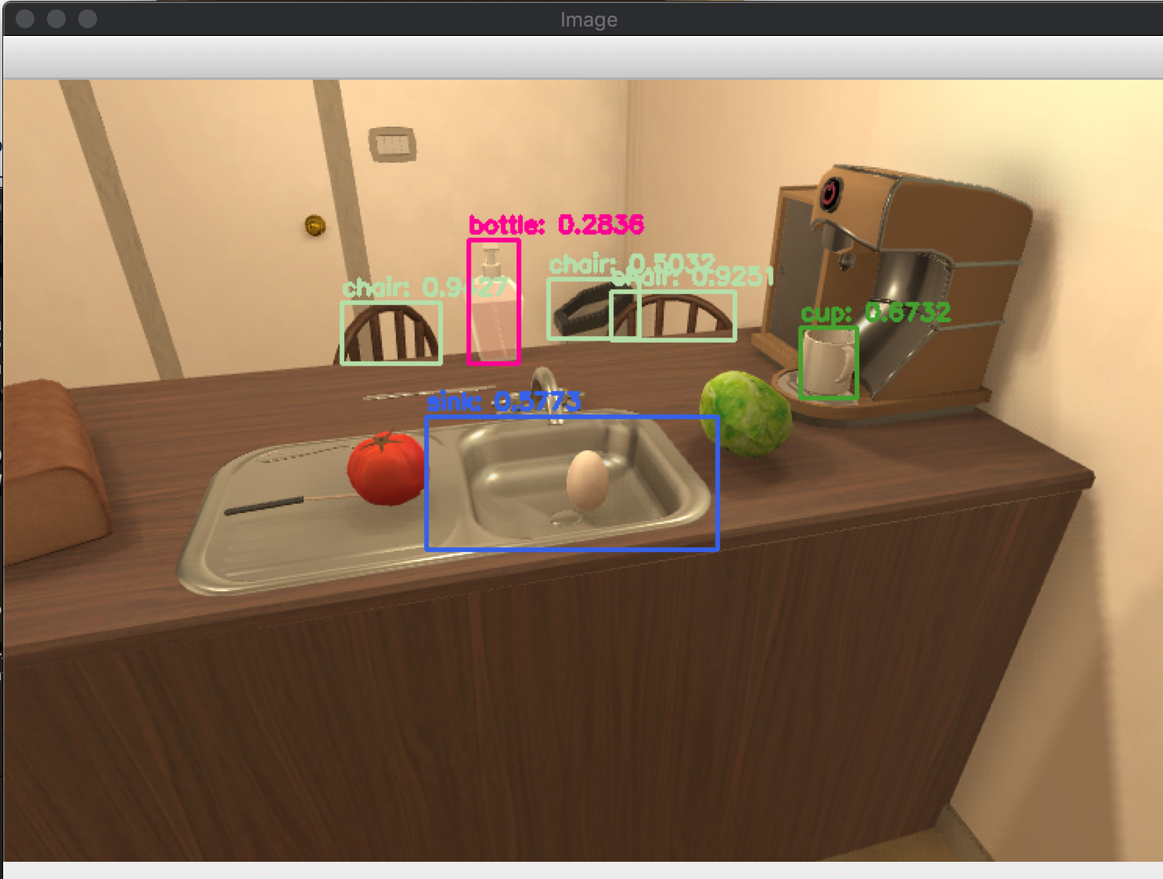
YOLO detection with Ai2thor
You can take picture and detect Object in room whenever you want after press key 'F'
Output: an image with bouding boxes are predicted

Slide 9
Challenge 02
Ideal:
Capture Top-view Image and Display location of Agent on this image
Draw Trajectories by Circle function of OpenCV distinguish by Color

Slide 10
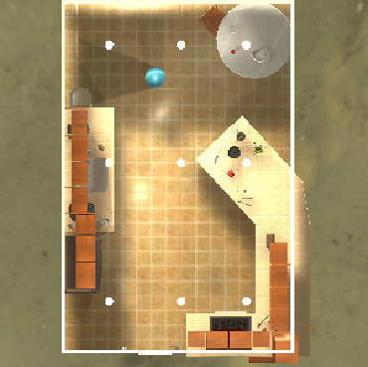
Capture Top-View Image
Using action ToggleMapView of ai2thor to get top-view frame
Extract it and add View triangle, after that save as png

Slide 11
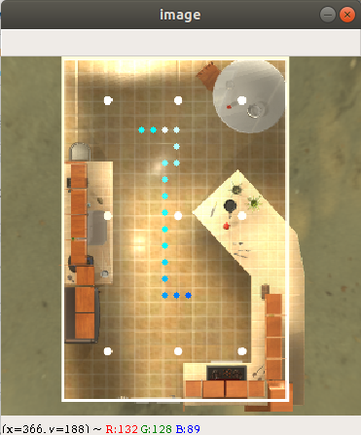
Draw Trajectories
1. Get the coordinates of Agent real-time
2. Calculate the distance of each step
3. Using cv2.circle to draw the Location with RGB color

